Slide 1
Project Meeting
2018/9/26

Slide 2
Kubernetes building
Goal:
Create a Cluster
Environment: Virtual Machine
CPU: 2 core
RAM: 4 RAM
Disk: 30 GB
OS: Ubuntu 16.04
Notes:
創建一個群集

Slide 3
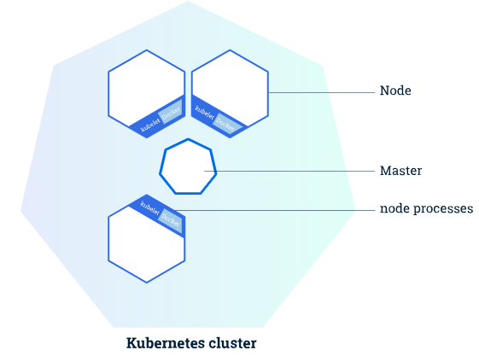
Create a Cluster
A Kubernetes cluster consists of two types of resources:
The Master coordinates the cluster
Nodes are the workers that run applications
Notes:
Master負責管理集群。主服務器協調集群中的所有活動，例如調度應用程序，維護應用程序的所需狀態，擴展應用程序以及推出新更新。
節點是VM或物理計算機，用作Kubernetes集群中的工作計算機。每個節點都有一個Kubelet，它是一個管理節點並與Kubernetes主站通信的代理。
The nodes communicate with the master using the Kubernetes API, which the master exposes

Slide 4
Essential component
Kubelet :the lowest level component in Kubernetes and responsible for what’s running on an individual machine
Kuebadm: used for administrating the Kubernetes cluster
Kubectl: used for controlling the configurations on various nodes inside the cluster
Notes:
Kubelet是Kubernetes中最低級別的組件。它負責在單個機器上運行的內容
Kuebadm用於管理Kubernetes集群
Kubectl用於控制群集內各個節點的配置

Slide 5
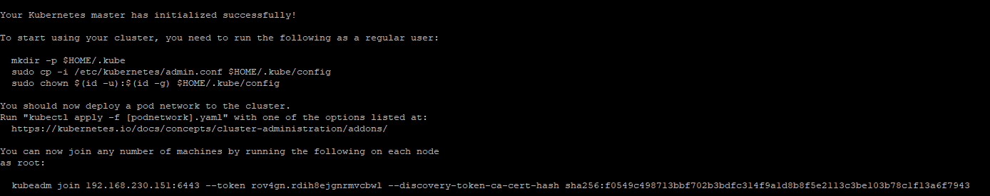

Result
Kubernetes initialized
Create a Cluster

